Slide 1

Working with Chat Completions Part 2

Slide 2
Dave Barry
“The Internet: transforming society and shaping the future through chat.”

Slide 3
Where We Left Off…
from openai import OpenAI
client = OpenAI()
completion = client.chat.completions.create(
model="gpt-4-turbo-preview",
messages=[
{"role": "system", "content": "You are an expert in penguins."},
{"role": "user", "content": "Give me a list of 10 species of penguins in the world. Just give me the list and nothing else."}
],
temperature=1,
max_tokens=256,
stop=None,
top_p=1,
frequency_penalty=0,
presence_penalty=0,
)
# After getting just the content of the message
print(completion.choices[0].message.content)
Notes:
from openai import OpenAI
client = OpenAI()
completion = client.chat.completions.create(
model="gpt-4-turbo-preview",
messages=[
{"role": "system", "content": "You are an expert in penguins."},
{"role": "user", "content": "Give me a list of 10 species of penguins in the world. Just give me the list and nothing else."}
]
)
# Before getting just the content
print(completion.choices[0].message)
# After getting just the content of the message
print(completion.choices[0].message.content)

Slide 4
Let’s Go Even Deeper
Beyond the Core Arguments
Notes:
https://platform.openai.com/docs/api-reference/chat/create

Slide 5
What Are Our Options?
messages
model
frequency_penalty
logit_bias
logprobs
top_logprobs
max_tokens
n
presence_penalty
response_format
seed
stop
stream
temperature
top_p
tools
tool_choice
user
Notes:
https://platform.openai.com/docs/api-reference/chat/create

Slide 6
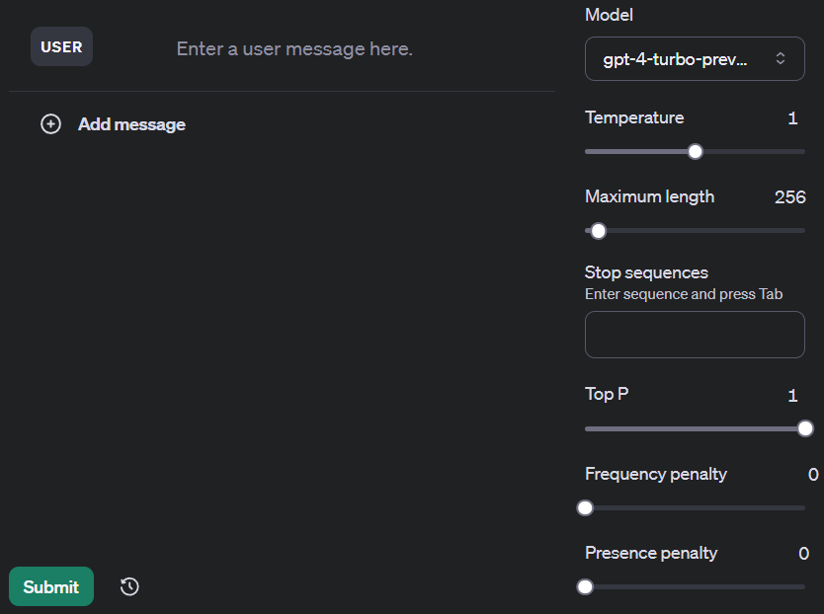
What You Already Know
messages
model
temperature
max_tokens
stop
top_p
frequency_penalty
presence_penalty
Notes:
https://platform.openai.com/playground/chat
https://platform.openai.com/docs/api-reference/chat/create

Slide 7
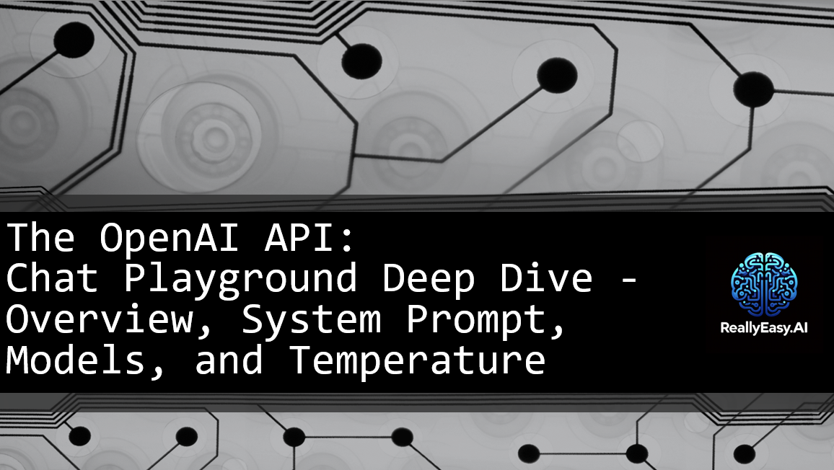
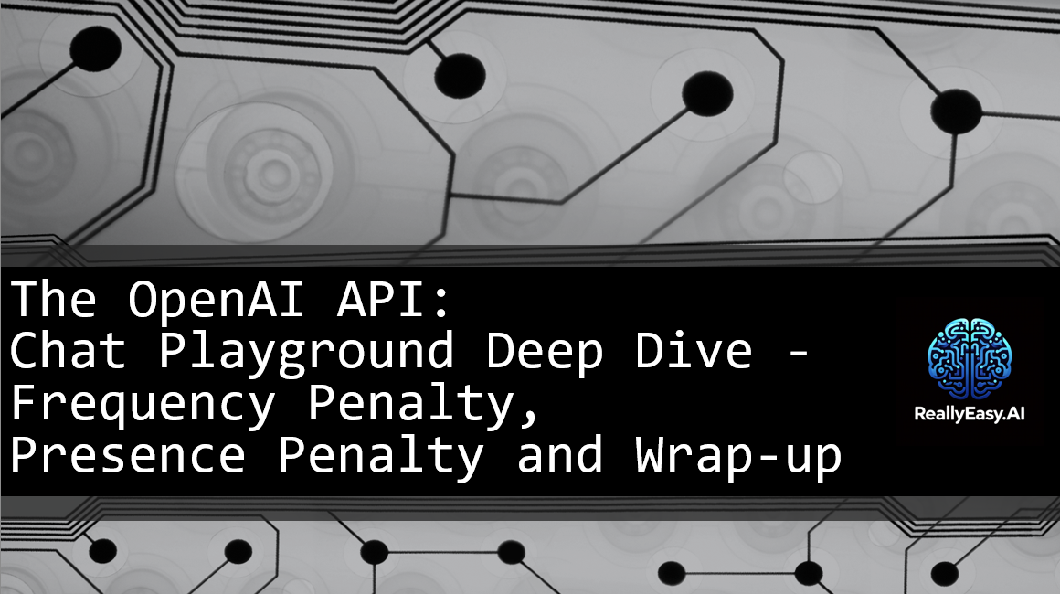

Slide 8
Number of Choices
The n argument
Notes:
https://platform.openai.com/docs/api-reference/chat/create#chat-create-n

Slide 9
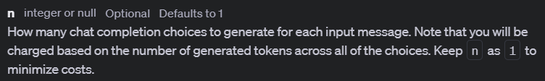
Notes:
https://platform.openai.com/docs/api-reference/chat/create#chat-create-logprobs
https://platform.openai.com/docs/api-reference/chat/create#chat-create-top_logprobs

Slide 10
JSON Mode
The response_format argument
Notes:
https://platform.openai.com/docs/api-reference/chat/create#chat-create-response_format

Slide 11
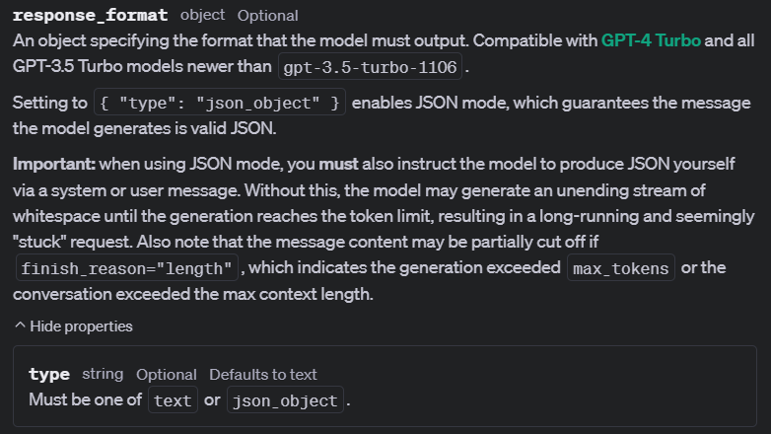

Slide 12
Deterministic Helper
The seed argument
Notes:
https://platform.openai.com/docs/api-reference/chat/create#chat-create-seed

Slide 13
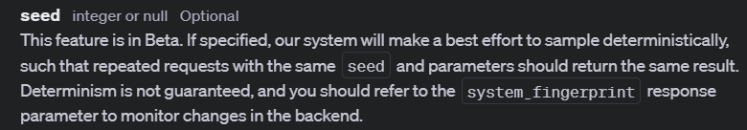

Slide 14
User Information
The user argument
Notes:
https://platform.openai.com/docs/api-reference/chat/create#chat-create-user
https://platform.openai.com/docs/guides/safety-best-practices

Slide 15

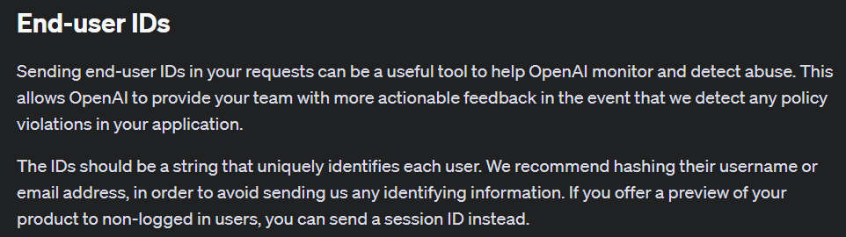

Slide 16


